Slide 1


Events App
Naman Goyal, Vishal Singh, Nitin Singh, Sarthak Gupta
CSP203
IIT Ropar – 25 April 2017

Slide 2
AIM
This app is to ease students’ stay at IIT Ropar, and provide one click access to all relevant event updates at the institute

Slide 3

Idea Behind The App
Chandigarh Trip
Late Night Dj
Festivals
Extra Lectures
Seminars
Quiz
Club Meeting And Orientation

Slide 4
Application
Frontend

Slide 5
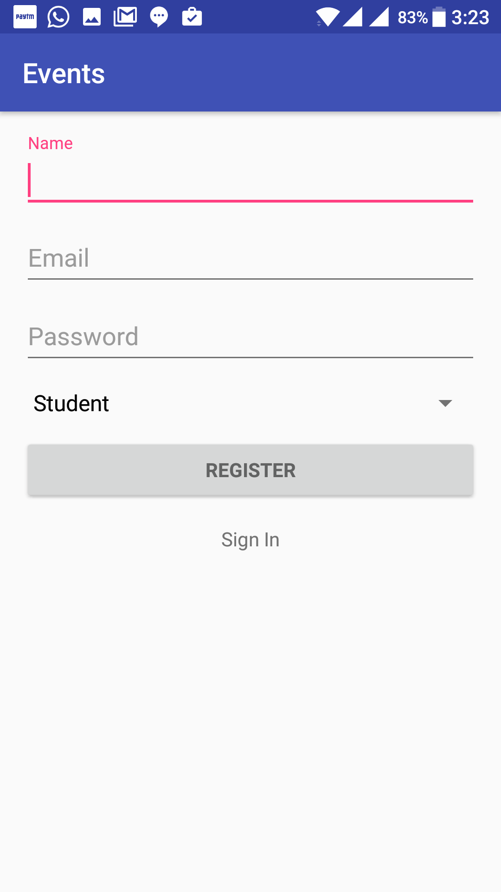
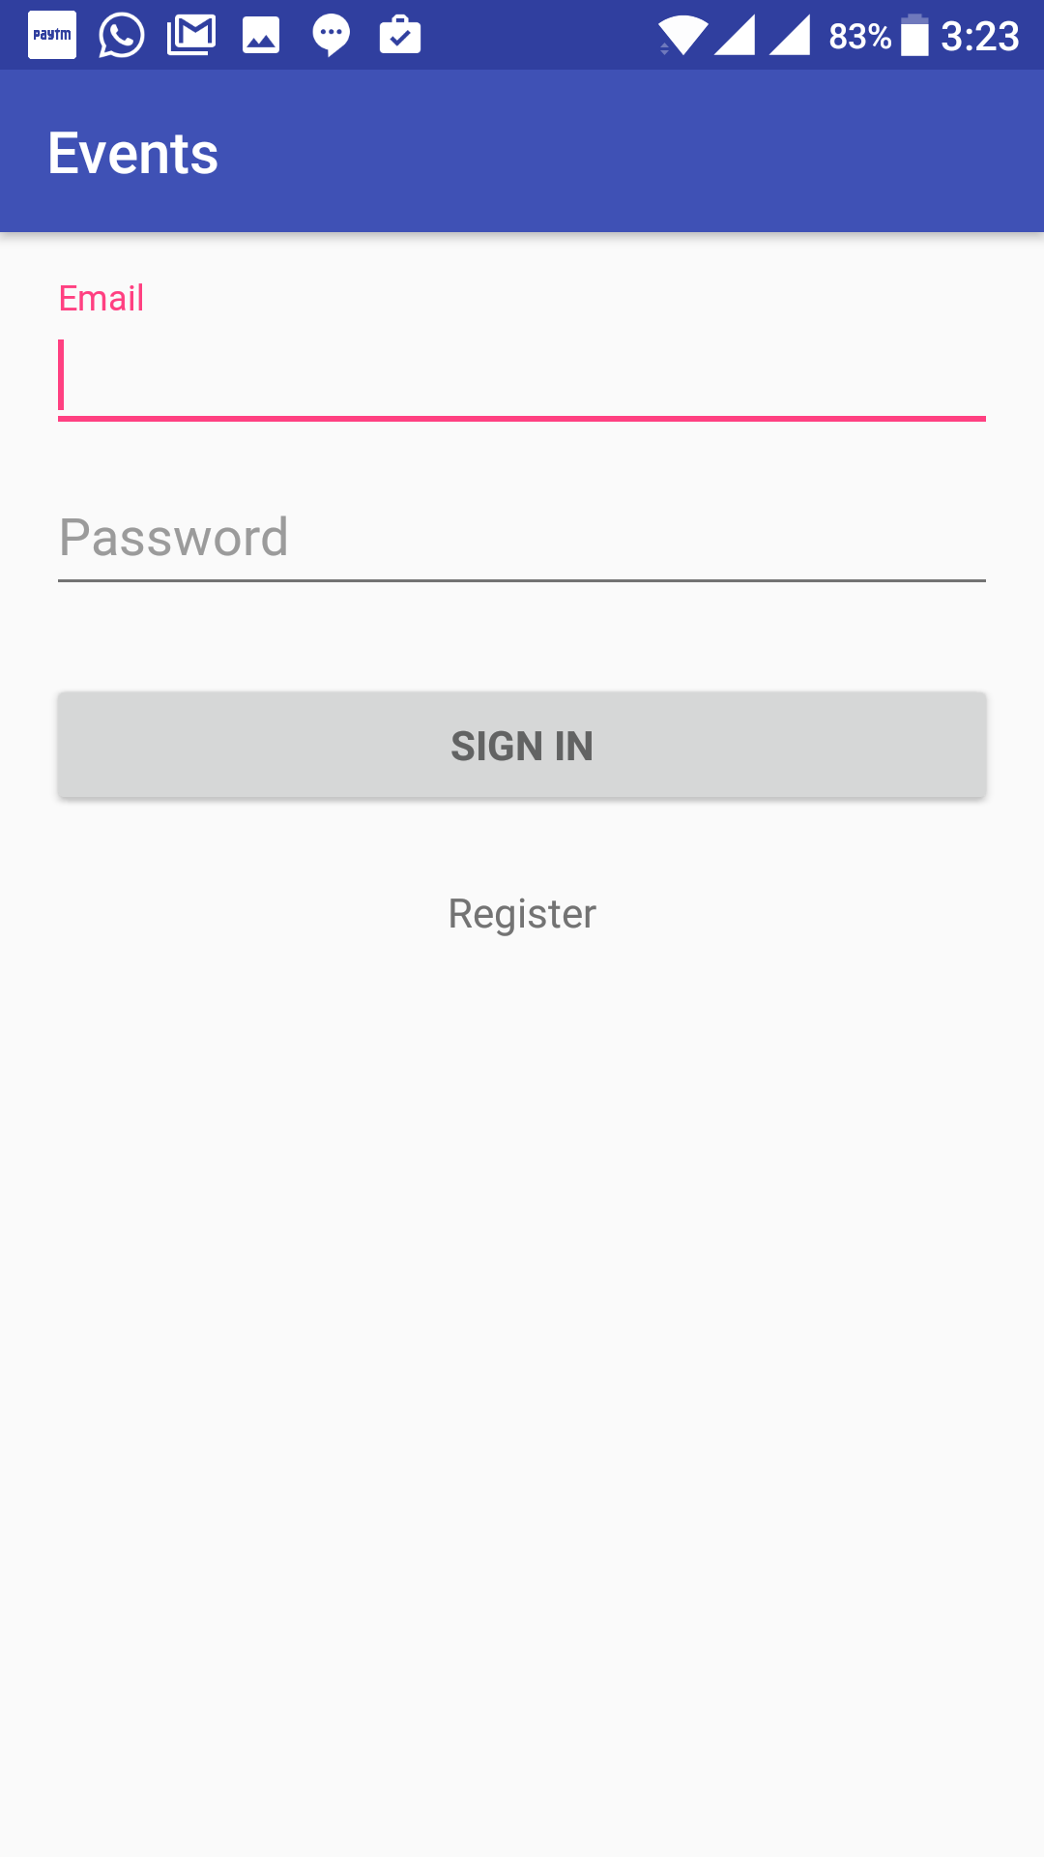
Login/ Registration
REGISTER SCREEN
(REGISTER USING YOUR IIT RPR EMAIL)
LOGIN SCREEN

Slide 6
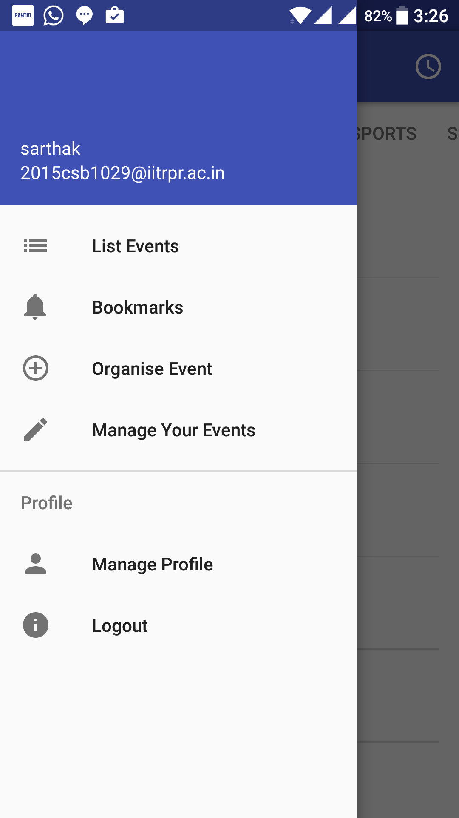
NAV-BAR
Redirects to list of events
Takes to list of bookmarks.
Takes to organize event activity
Helps to make changes to the events created
Lets you to manage your profile
Take you back to the login screen

Slide 7
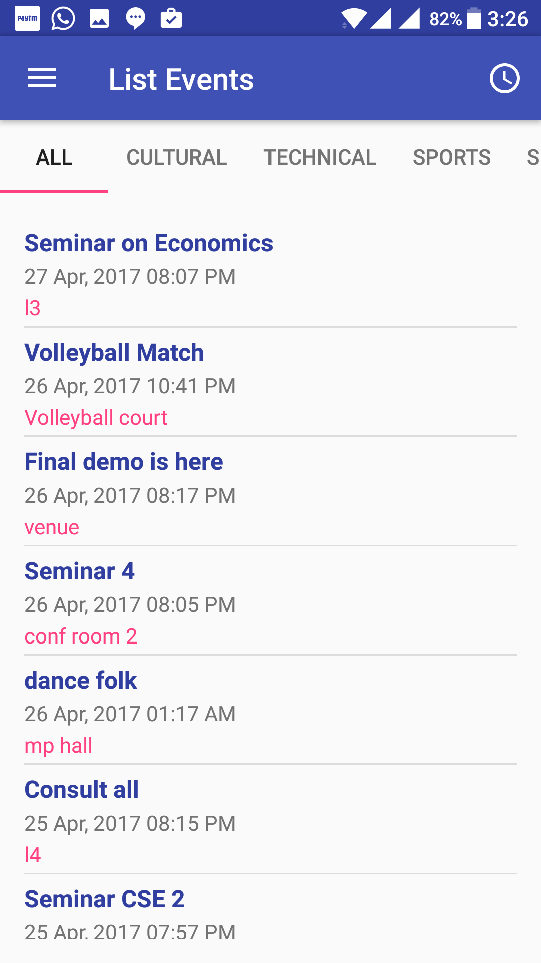
Listing Events
Types Of Events
Event Name
Date Showing When Event Will Start
Venue Is Given Here For Particular Event Type

Slide 8
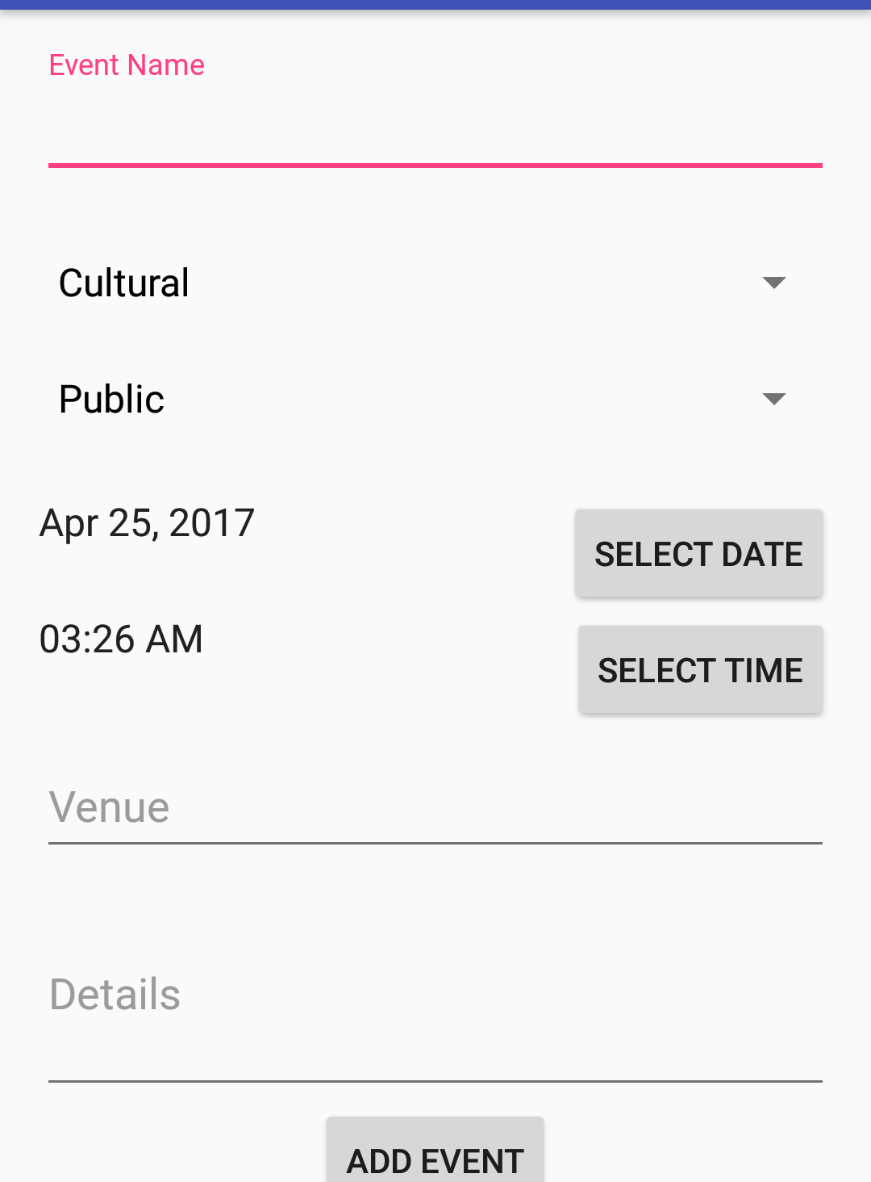
Organize Events
Lets you to select type of event
Lets you select the target audience and notify accordingly
Lets to select the date of event
Lets you to select the time of event
Here you can enter the venue of the event
Add details of the event

Slide 9
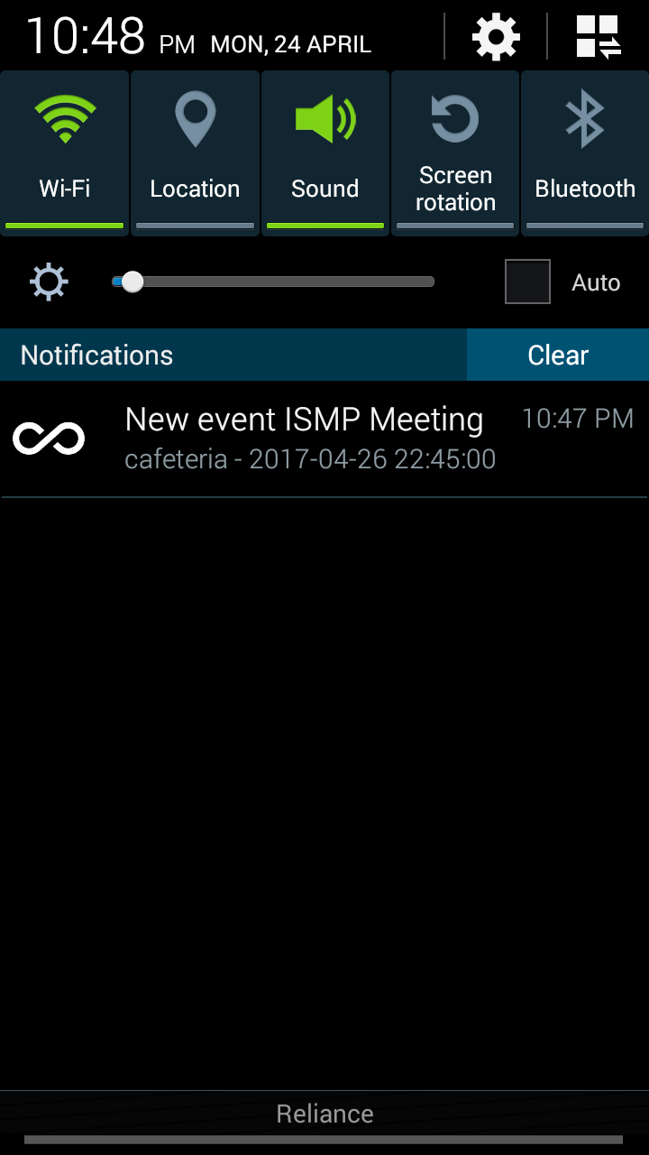
Notification
Notification received of new event created.
Received based on user type and visibility of event

Slide 10
Application
Works Offline
Memory Efficient - Only Required Data Is Loaded
Dynamic Listing All Category And User Types
Other Features

Slide 11
Server and API
Backend

Slide 12
Server and API
MYSQL Tables
PHP API Access
Firebase Integration
Features

Slide 13
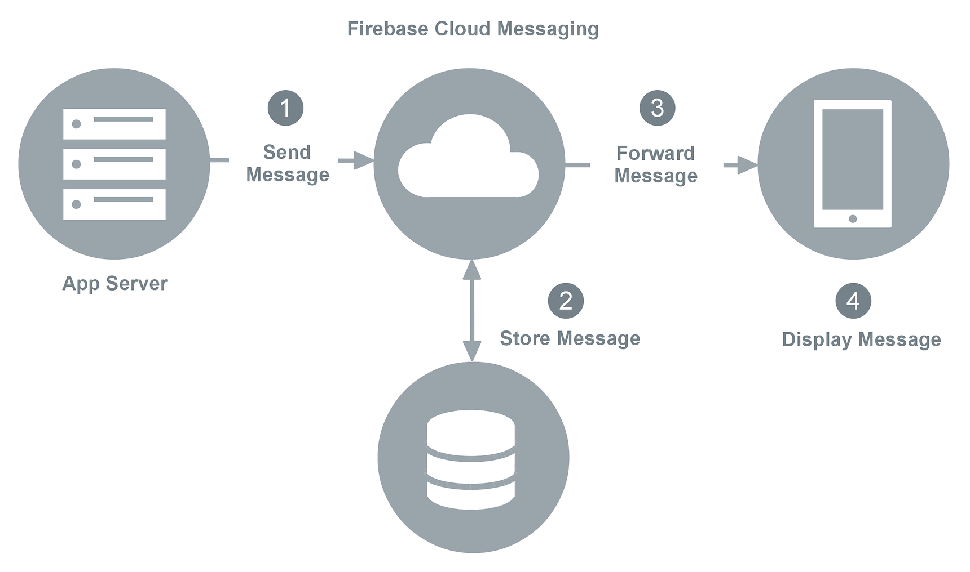
FIREBASE
Maintain Current Online App Instance
Enable Analytics
Cloud Messaging Enables Sending Broadcast And Notification

Slide 14
Contributions
Works Offline
Memory Efficient - Only Required Data Is Loaded
Inclusive to everyone - for creating events and notifying all concerned.

